Slide 1

AlphaFold2 on Alpine
RC Short Course
11 November 2024
Layla Freeborn
Notes:
AlphaFold2 is an open-source artificial intelligence program that predicts the 3D structure of proteins based on their amino acid sequence. The program and its underlying algorithm solve a long-standing problem in structural biology, so adoption by the research community has been swift and enthusiastic. Running AlphaFold2 involves a simple input file and few parameter specifications, but requires access to large-scale computational resources such as GPUs and enough RAM to perform a search against a collection of datasets exceeding 2 TB. This session, aimed at researchers and research facilitators, will provide an overview of running AlphaFold2 on Alpine, covering performance considerations and limitations, predicting monomer and multimer proteins, checking AlphaFold2 outputs, and how to take advantage of spin-offs like ParaFold. Participants will receive training accounts for Alpine and can follow along using a hands-on example.

Slide 2

Slides
https://bit.ly/af2alpine
Notes:
alphafold distributed as a docker container, usually run on HPC systems in a singularity container – we use https://github.com/prehensilecode/alphafold_singularity
alphafold databases (~2 TB; db versions are matched to alphafold versions)- recommend using our DBs to avoid redundancy
Google CoLab- offers some setting not available in the docker container, uses a different search search algorithm for MSAs
check to see if your protein is already predicted (check PDB)
Compared to ColabFold (see Using (Local)ColabFold on O2 ), AlphaFold takes fewer parameters, and uses jackhmmer as an MSA generator instead of mmseqs2, which can make it slower than ColabFold for certain inputs. It may also require more resources to run. If you are unsure about which to use, feel free to try both tools and compare results.
Before starting: if you are working with a single protein, check to see if it has not already been previously computed. A full database can be found at AlphaFold Protein Structure Database . It may save you a lot of time!

Slide 3
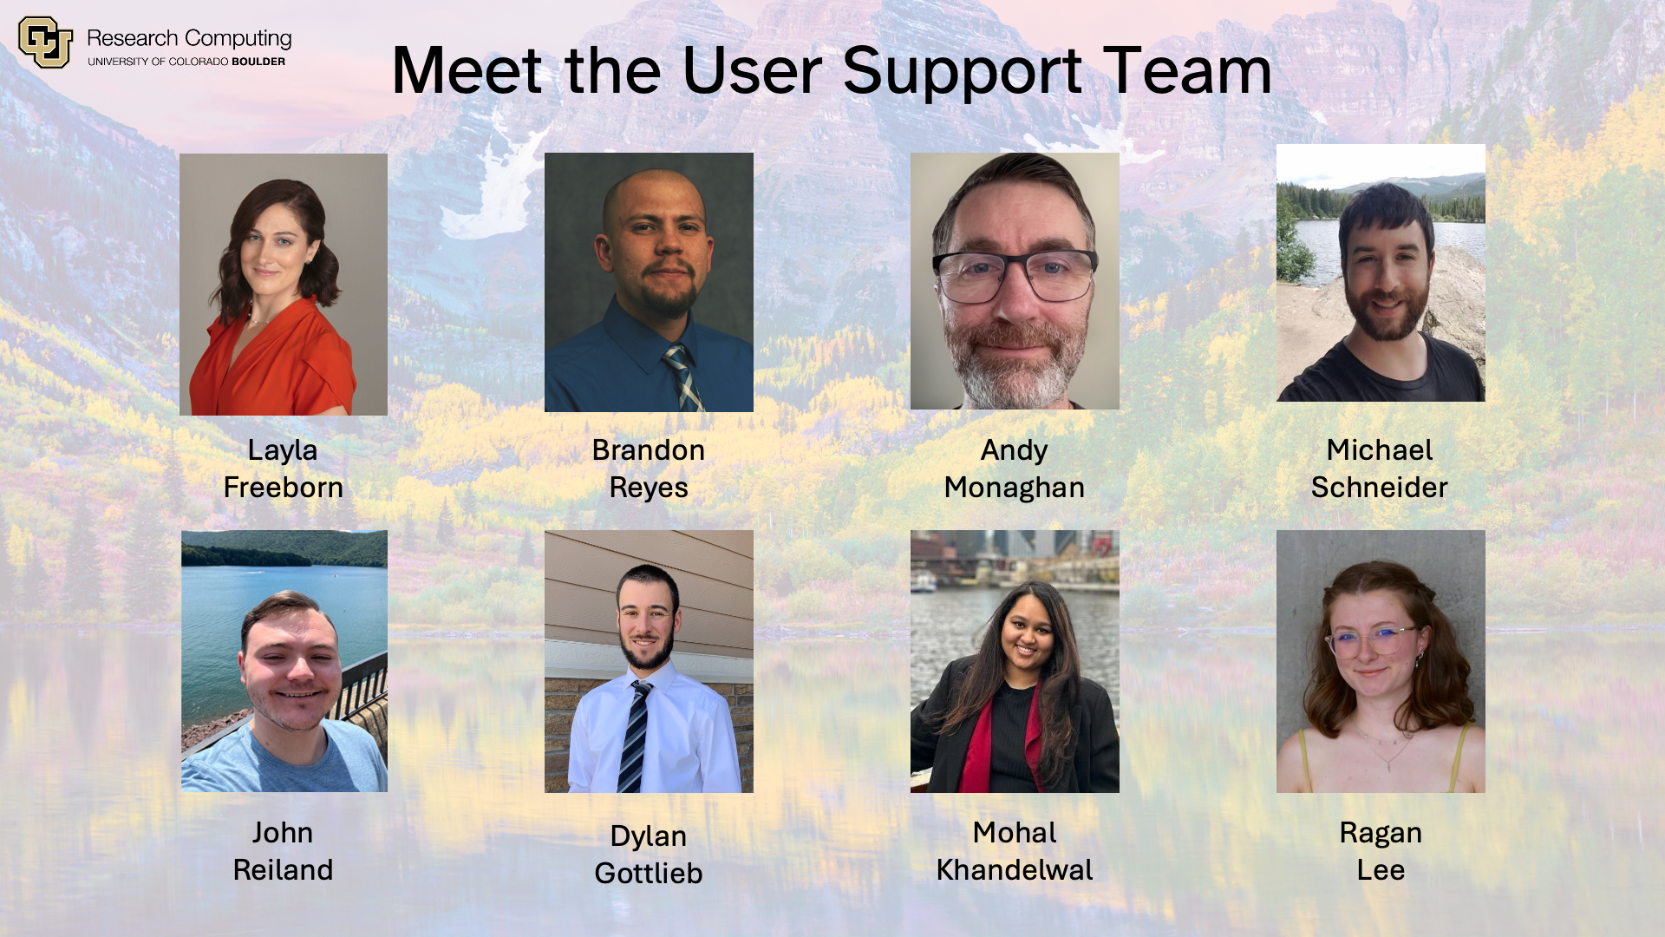
CURC User Support
Notes:
alphafold distributed as a docker container, usually run on HPC systems in a singularity container – we use https://github.com/prehensilecode/alphafold_singularity
alphafold databases (~2 TB; db versions are matched to alphafold versions)- recommend using our DBs to avoid redundancy
Google CoLab- offers some setting not available in the docker container, uses a different search search algorithm for MSAs
check to see if your protein is already predicted (check PDB)
Compared to ColabFold (see Using (Local)ColabFold on O2 ), AlphaFold takes fewer parameters, and uses jackhmmer as an MSA generator instead of mmseqs2, which can make it slower than ColabFold for certain inputs. It may also require more resources to run. If you are unsure about which to use, feel free to try both tools and compare results.
Before starting: if you are working with a single protein, check to see if it has not already been previously computed. A full database can be found at AlphaFold Protein Structure Database . It may save you a lot of time!

Slide 4
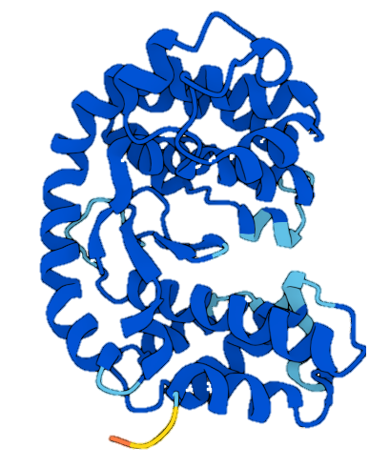
Background: The Protein Folding Problem
What a protein does (it’s biological function) depends on its 3D structure
Figuring out the what shapes a protein folds into has been a grand challenge in biology for 50+ years
Can we predict a protein’s 3D structure based on its
1D aa sequence?
This is computationally VERY intensive!
Notes:
A major challenge, however, is that the number of ways a protein could theoretically fold before settling into its final 3D structure is astronomical. In 1969 Cyrus Levinthal noted that it would take longer than the age of the known universe to enumerate all possible configurations of a typical protein by brute force calculation –

Slide 5
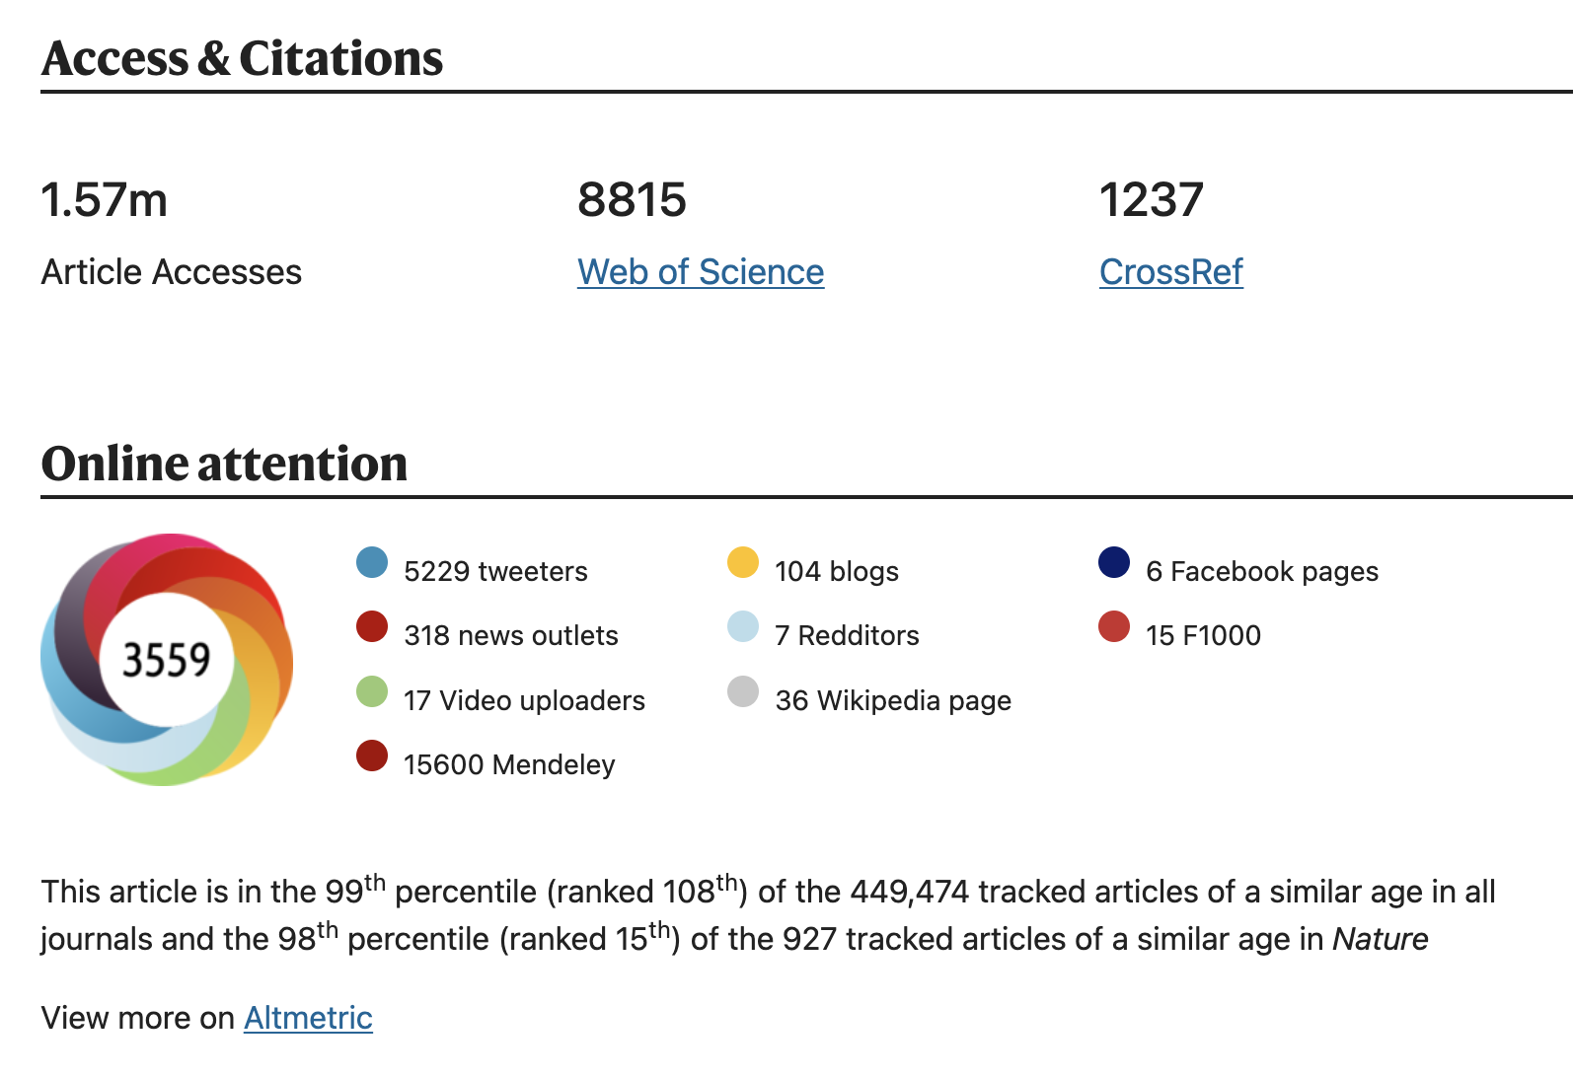
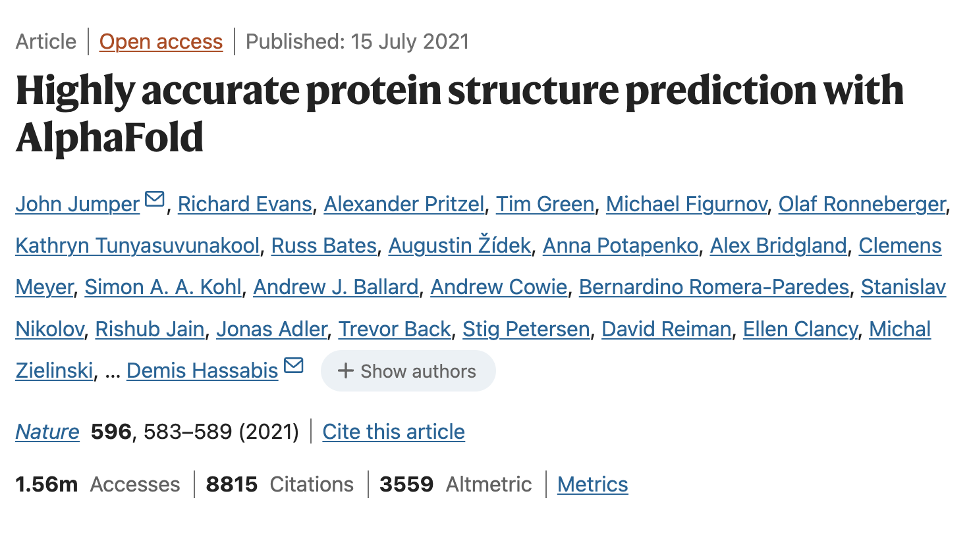
Background
Notes:
In a major scientific advance, the latest version of our AI system AlphaFold has been recognized as a solution to this grand challenge by the organizers of the biennial Critical Assessment of protein Structure Prediction (CASP). This breakthrough demonstrates the impact AI can have on scientific discovery and its potential to dramatically accelerate progress in some of the most fundamental fields that explain and shape our world.

Slide 6
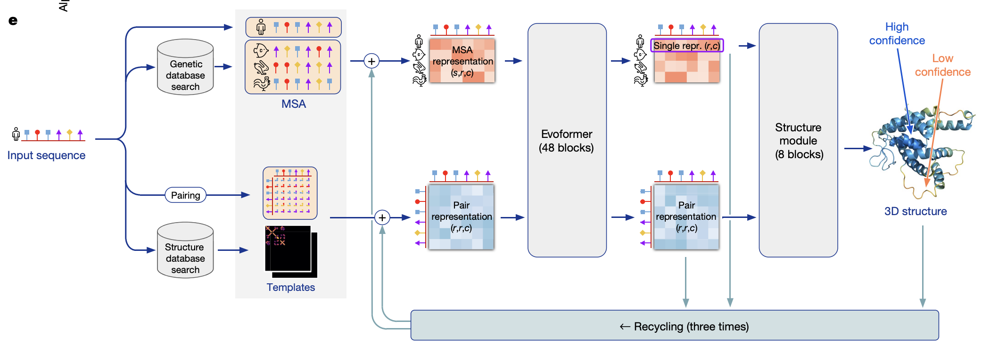
The Pipeline
Notes:
Database search- MSA Construction- For each sequence specified, a multiple sequence alignment (MSA) search is launched and a template search is done.
Model Inference- The MSA and templates are given to five identical neural network architectures. This is showing one model.

Slide 7
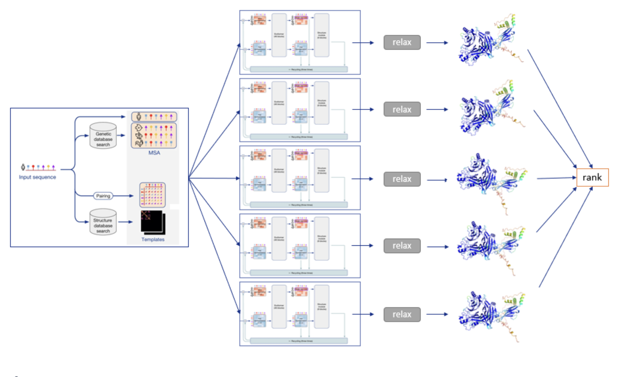
The Pipeline: CPU vs GPU
(CPU)
(GPU)
Notes:
This figure represents the five models, which all have the same network architecture, but different parameters following five independent training stages with different randomization seeds. Thus, they will predict slightly different 3-D structures.
This yields five 3-D structures, which are optionally relaxed and finally ranked according to the model’s confidence.
The relaxation step is optional- They also use the AMBER force-field (which is a simulation of the atoms based on chemical principles) to "relax" the protein sequence at some points. This does not improve accuracy by the atom-to-atom distance measures, but it does remove physically impossible occlusions of atoms.
When set to True, this will skip running AMBER molecular dynamics simulations to relax amino acid side chain position. AMBER relaxation takes additional time that is usually not needed. AMBER relaxed models are required for users who need accurate side-chain positions (e.g., phasing X-ray diffraction datasets). Most users do not need this performed.

Slide 8
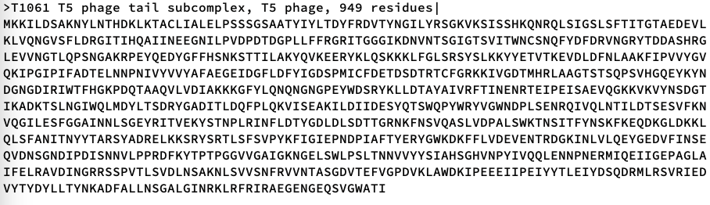
AlphaFold Inputs
FASTA file (e.g., dummy.fasta, T1061.fa)
A FASTA file is the only required AlphaFold input.
Notes:
The only required input is the amino acid sequence of your protein of interest. However, you may also supply additional data to guide AlphaFold2’s structure prediction. AlphaFold2 will output the predicted structure of the protein, accompanied by confidence scores such as pLDDT and PAE.

Slide 9
Alpine AlphaFold2 Module
Loading the AlphaFold module (ml alphafold)
activates a conda environment containing all the necessary packages
redirects TMPDIR to /scratch/alpine/$USER
creates a shortcut to the AlphaFold run script
sets convenient environment variables
$CURC_AF_DBS
$CURC_AF_EXAMPLES

Slide 10
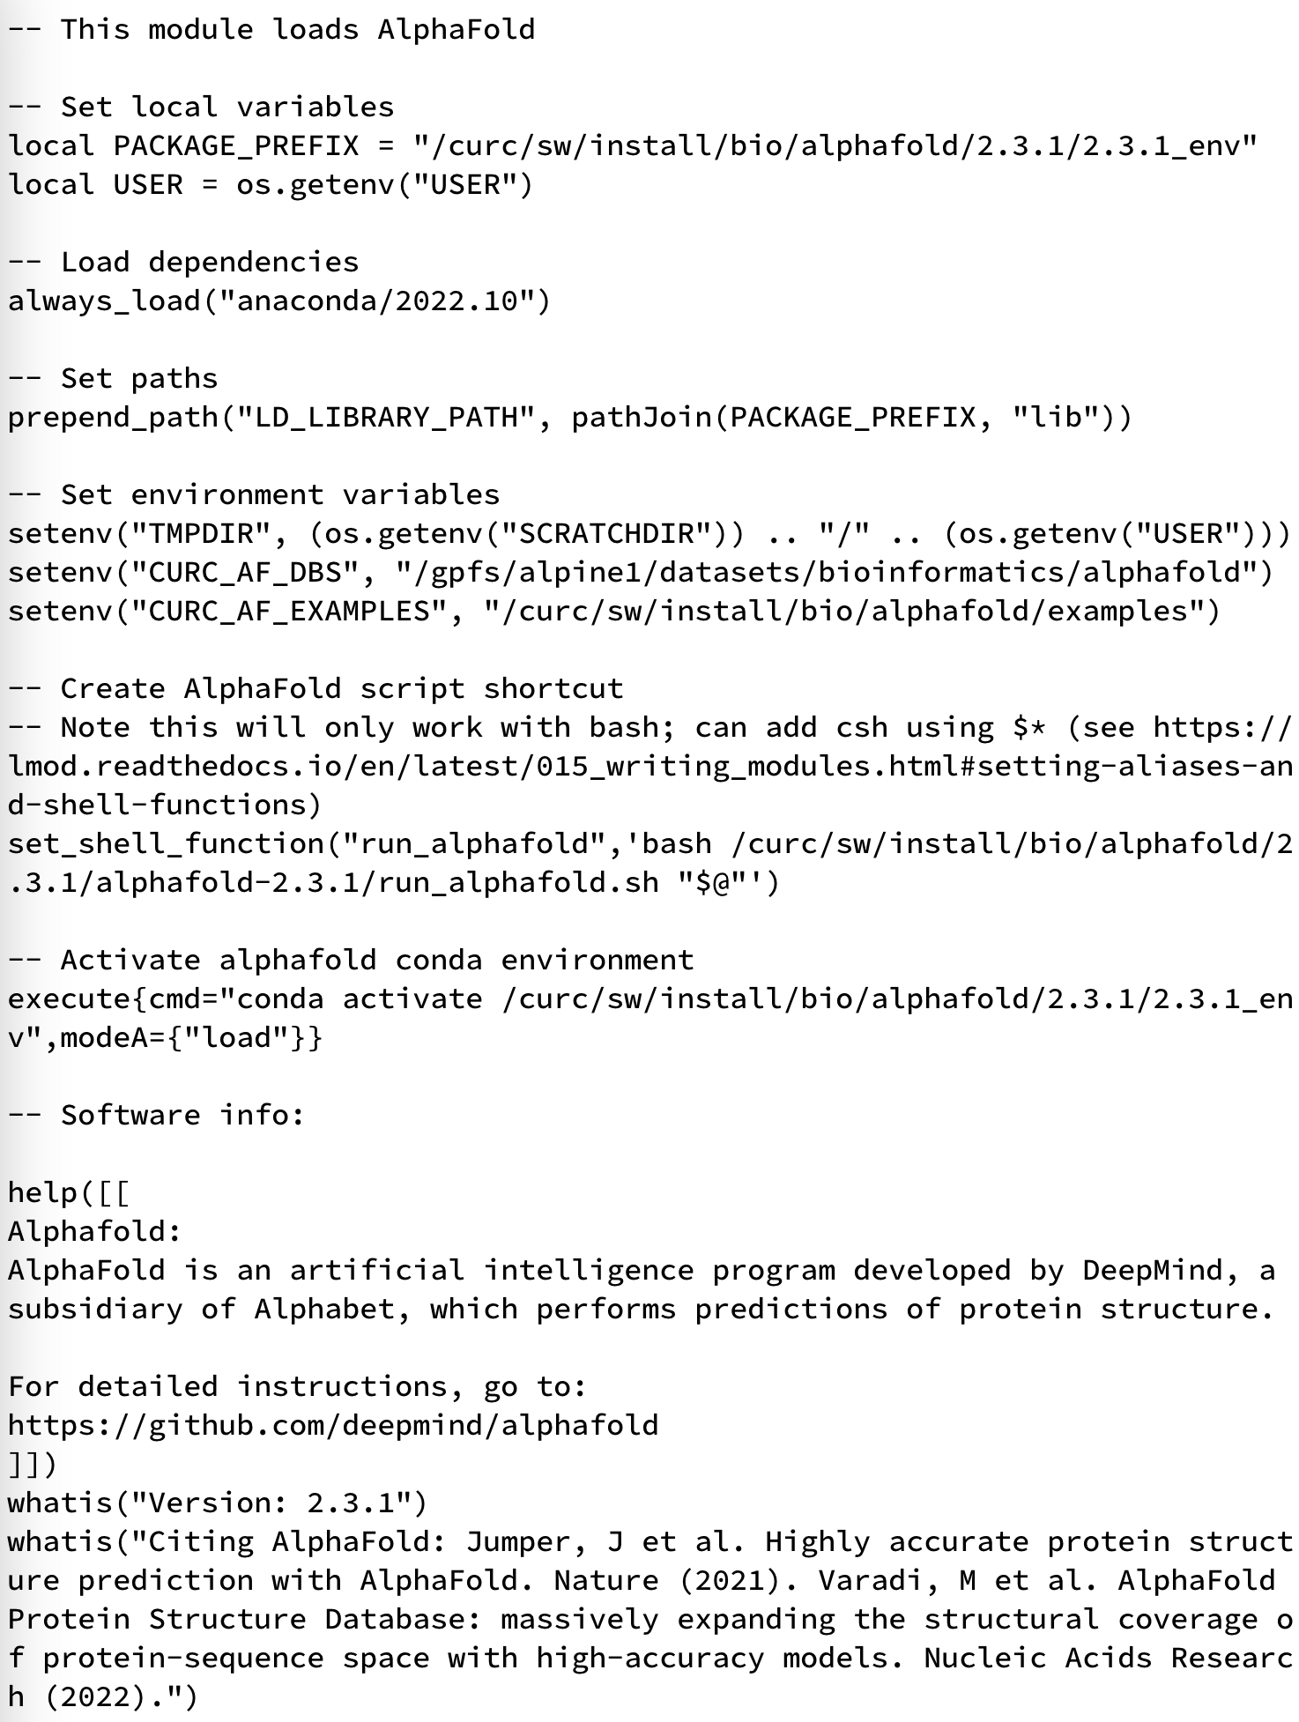
Alpine AlphaFold2 Module
sets environment variables/redirects TMPDIR
creates a shortcut to run_alphafold.sh

Slide 11
Alpine AlphaFold2 Module
activates the AlphaFold conda environment

Slide 12
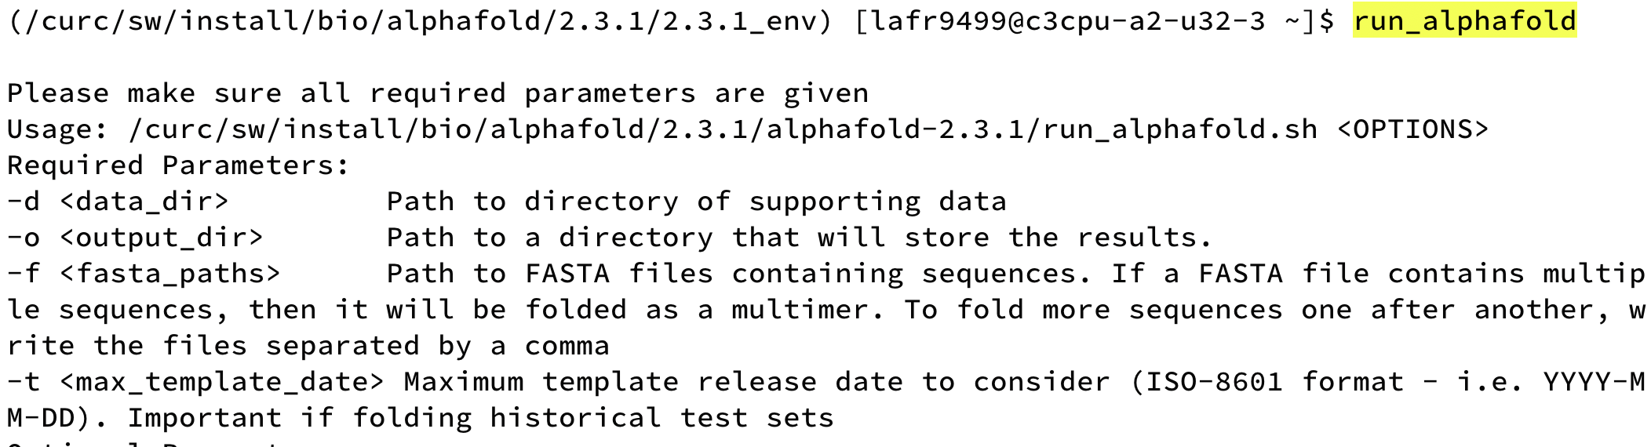
AlphaFold2 Required Parameters
To predict the structure of a protein in the PDB without using its experimental structure as a template, set max_template_date (-t) to before the release date of the structure.
TIP: A date like 1900-01-01 will ensure no templates are used.
Notes:
If you have multiple protein sequences from the same organism, running multiple monomers in one job script will significantly speed up processing.
To predict the structure of a protein already in PDB without using its experimental structure as a template set max_template_date to before the release date of the structure. For example, to reproduce the T1049 CASP14 target with 144 aa. On a V100x this prediction runs for about 1h.
specifies the latest date to reference when matching against templates. As of 2.2.0, there is no way to “turn off” templates - you can simply provide a very early date to make sure no templates survive the date filter, e.g. --max_template_date=1950-01-01

Slide 13
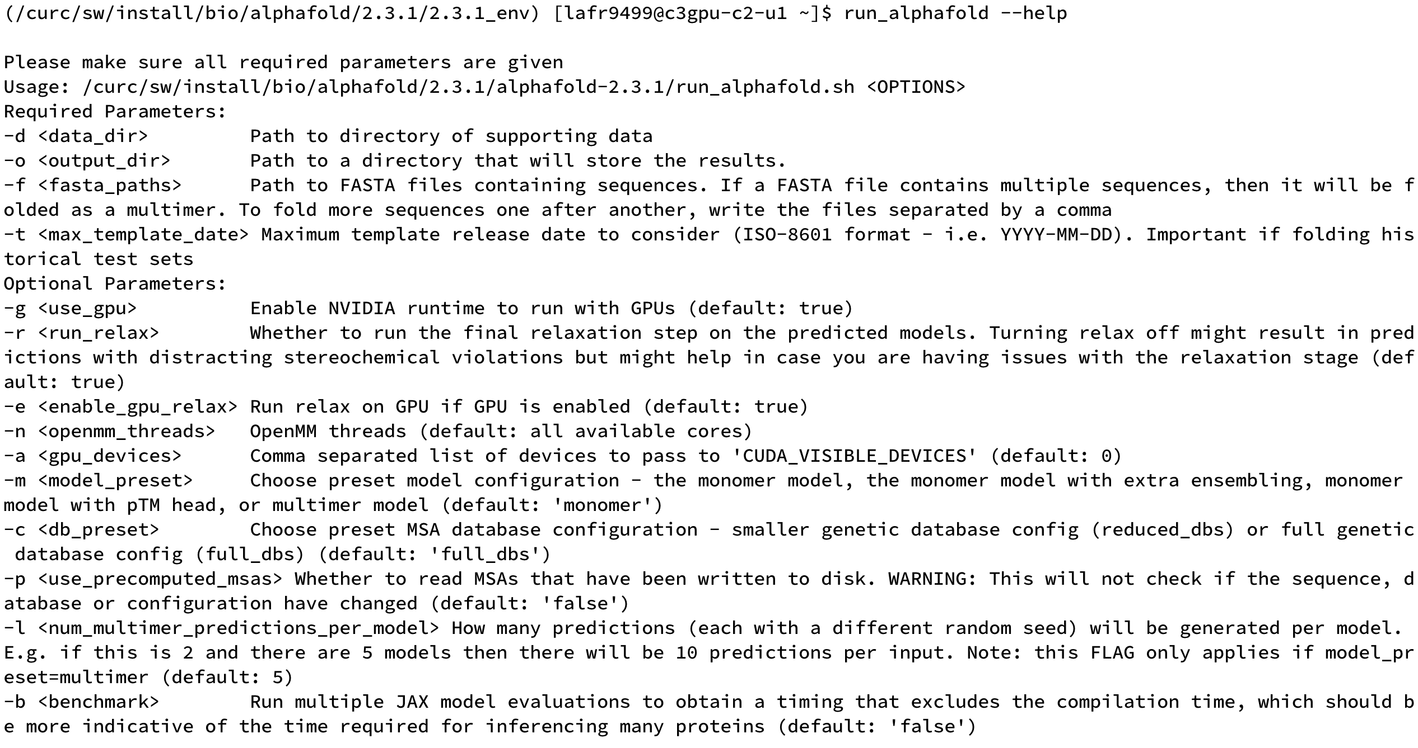
AlphaFold2 Optional Parameters
Parameter values for --model_preset (-m):
monomer
monomer_casp14
monomer_ptm
multimer
Notes:
monomer_casp14
monomer_ptm
monomer
multimer

Slide 14
AlphaFold2 Optional Parameters Cont’d
Using precomputed MSAs: AlphaFold looks for the MSAs in the output directory, so they must stay the same if you want to reuse them.

Slide 15
Folding Monomers (1 Polypeptide Chain)
The default model preset is monomer prediction (--model_preset=monomer or -m “monomer”)
Requires a FASTA file with a single sequence
Run Command: run_alphafold -d $CURC_AF_DBS -o .
-f $CURC_AF_EXAMPLES/dummy.fasta -t 2020-05-14
-m “monomer” -g true
Notes:
monomer is the default, as is -g true (when GPU is detected; will default to CPU if not)

Slide 16
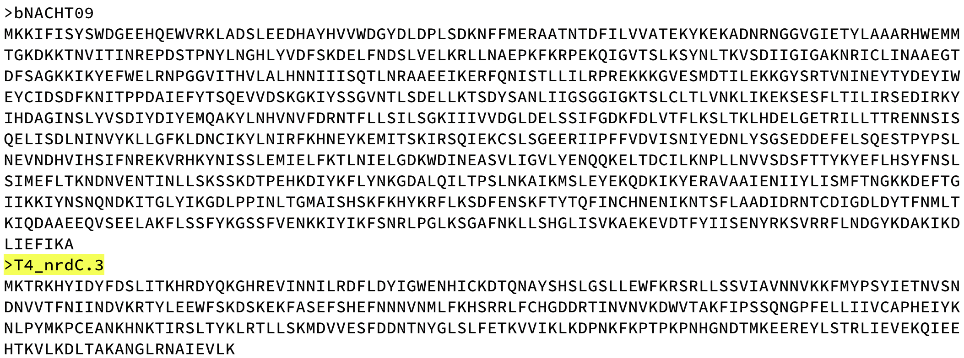
Folding Multimers (>1 Polypeptide Chain)
Requires a FASTA file containing multiple sequences
Run Command: run_alphafold -d $CURC_AF_DBS -o .
-f $CURC_AF_EXAMPLES/multimer.fa -t 2020-05-14
-m “multimer” -g true
Notes:
If a FASTA file contains multiple sequences, then it will be folded as a multimer. To fold more sequences one after another, write the files separated by a comma

Slide 17
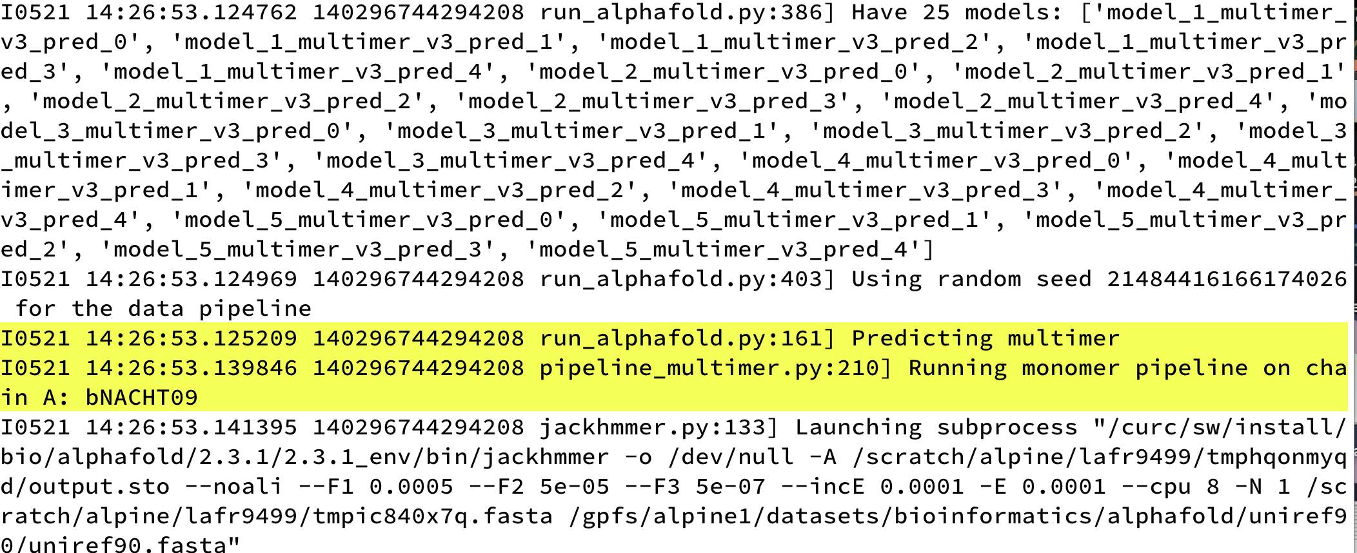
Folding Multimers (>1 Polypeptide Chain Cont’d)
Notes:
If a FASTA file contains multiple sequences, then it will be folded as a multimer. To fold more sequences one after another, write the files separated by a comma

Slide 18
Example Job Script
An example job script is located in /curc/sw/install/bio/alphafold/2.3.1
Copy to any space you have write permissions and make your desired changes:
cd /projects/$USER
cp /curc/sw/install/bio/alphafold/2.3.1/alphafold_alphine.sh .

Slide 19
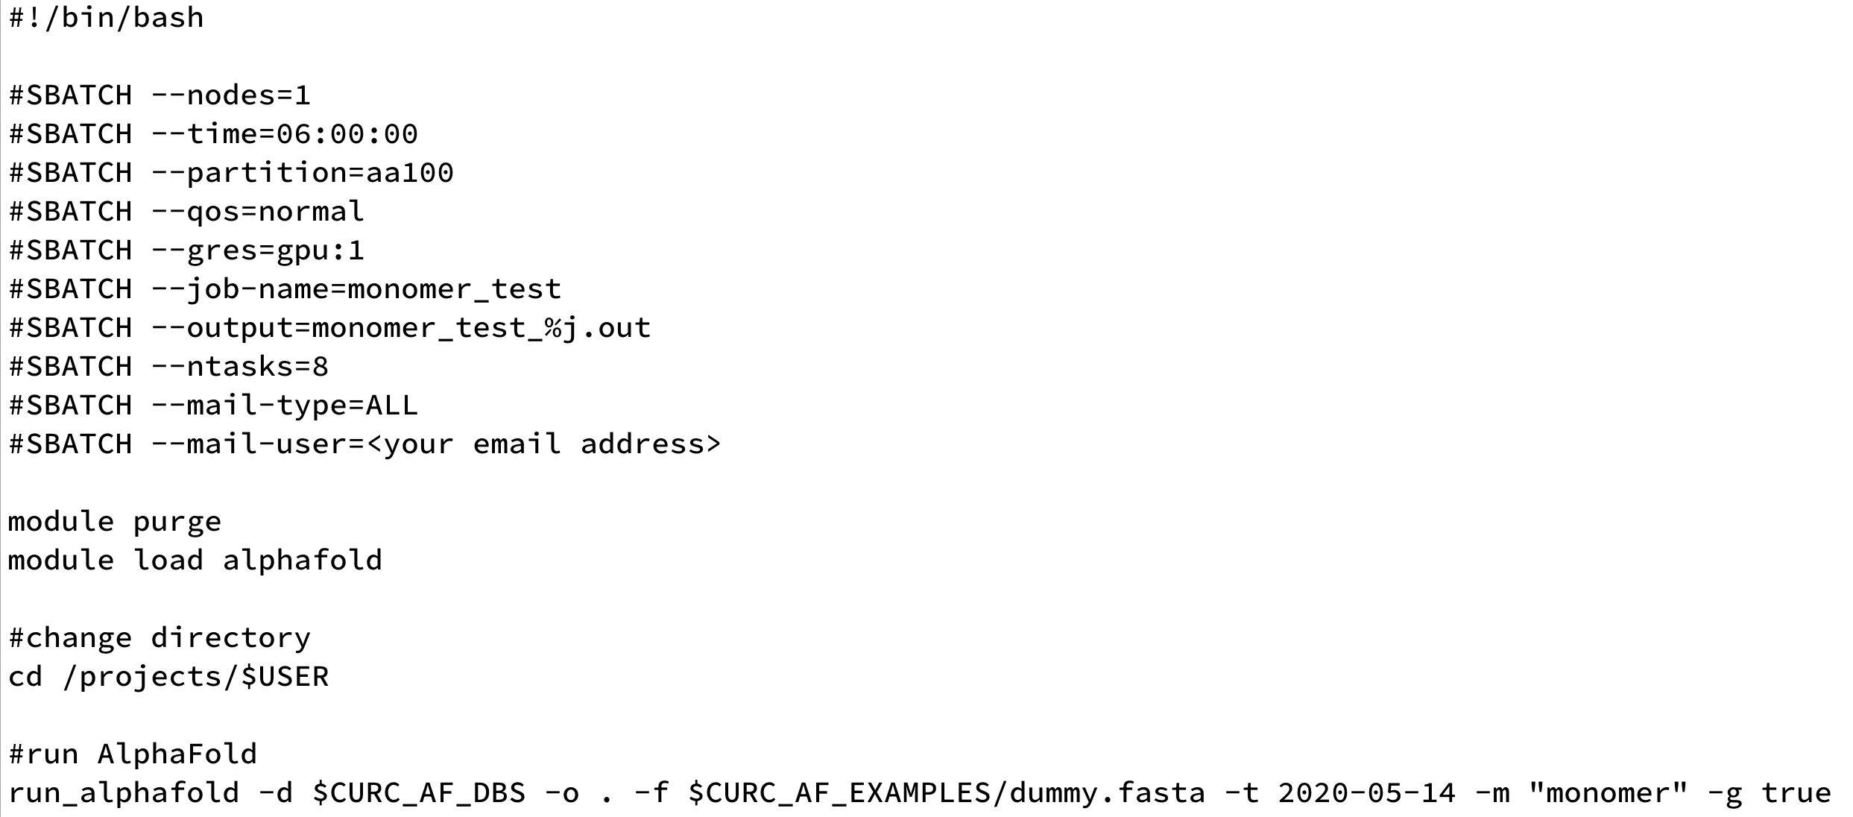
Example Job Script
Notes:
note –mem directive is not included here (more on that later)

Slide 20
AlphaFold2 Outputs Overview
Slurm .out file (e.g., short_course_dummy_out_example.out)
progress
warnings or errors
a directory with the FASTA name (e.g., dummy)
computed MSAs
unrelaxed, relaxed, and ranked structures
raw model outputs
prediction metadata
timing information

Slide 21
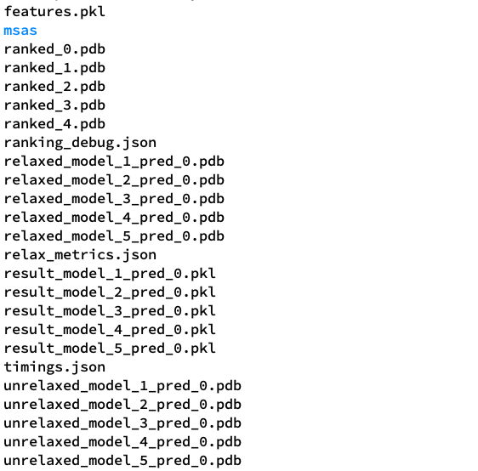
AlphaFold2 Outputs Explained 1
relaxed version of the predicted structures, ranked based on model confidence (ranked_0.pdb has the highest confidence)
.pdb protein database format (human readable)
relaxed version of the predicted structures
not yet relaxed predictions from each AlphaFold model
Notes:
Per-residue pLDDT scores (plddt contains a NumPy array of shape [N_res] with the range of possible values from 0 to 100, where 100 means most confident). This can serve to identify sequence regions predicted with high confidence or as an overall per-target confidence score when averaged across residues.
The pLDDT confidence measure is stored in the B-factor field of the output PDB files (although unlike a B-factor, higher pLDDT is better, so care must be taken when using for tasks such as molecular replacement).
In order to hold practical significance, predicted protein structures must be accompanied by reliable measures of confidence. AlphaFold2 returns two confidence measures called pLDDT and PAE. These metrics can be used to identify regions of the predicted structure, and relative positions of different regions, that are more or less reliable. All predicted structures should be interpreted critically and in the light of these confidence scores.

Slide 22
AlphaFold2 Outputs Explained 2
processed MSA information (NumPy arrays), used as input to produce structures
.pkl
pickle data format (binary; not readable)
outputs in .pkl format. includes pLDDT and PTM values

Slide 23
AlphaFold2 Outputs Explained 3
.json (readable data format)
info on the pLDDT (confidence score) of each model and how they were ranked
relax metrics, including remaining violations
info on how long each section of the pipeline took to run

Slide 24
AlphaFold2 Outputs Explained 4
A directory containing the files describing the various genetic tool hits that were used to construct the input MSA
Files in the msas directory are in various file formats, all human readable

Slide 25
Visualizing Outputs
To date we have left this up to the user
Some options are
AlphaPickle: https://github.com/mattarnoldbio/alphapickle
PyMol (free for education): https://pymol.org/
AlphaFold Protein Structure Database website provides a great resource for learning how to interpret visualizations:
https://alphafold.ebi.ac.uk/entry/Q9Y223#help
Notes:
People have their own preferences and doesn’t require a lot of compute

Slide 26
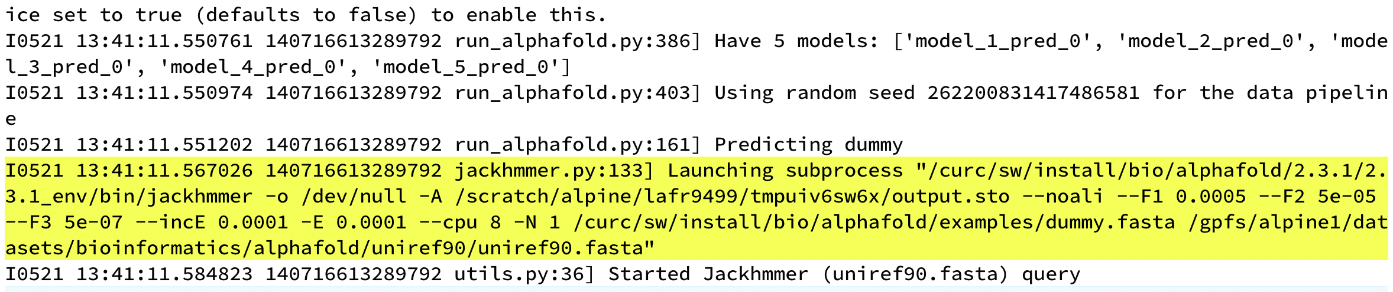
AlphaFold2 Performance Considerations
The number of cores/threads used during MSA steps is hardcoded and so AF cannot use more than 8 CPU cores. Requesting more cores will not improve performance and you may end up waiting longer for your job to start.
Notes:
Real bummer.
Some people have gone in and modified this. At CURC, we haven’t invested the time in doing that, but I can see how it may be worth it for some Centers.
Runtimes are variable

Slide 27
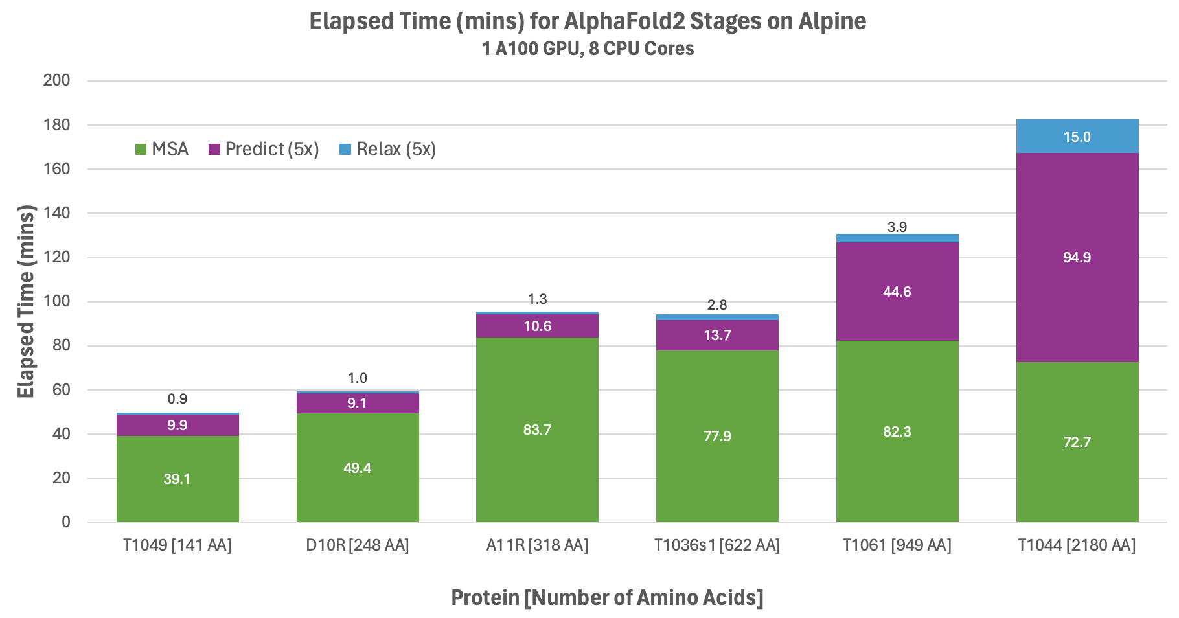
AlphaFold2 Elapsed Time
Notes:
When looking at prediction times, summed for all five AlphaFold models, we see that longer primary sequences means longer prediction times. benchmarks on other systems have shown quadratic increases in prediction time;
we also see that with a 2000 residue sequence, we can see more time spent on the GPU than the CPU. I’ve read that in general, for sequences with less than ~1200 residues, more time is spent on the MSA search than on the actual predictions.

Slide 28
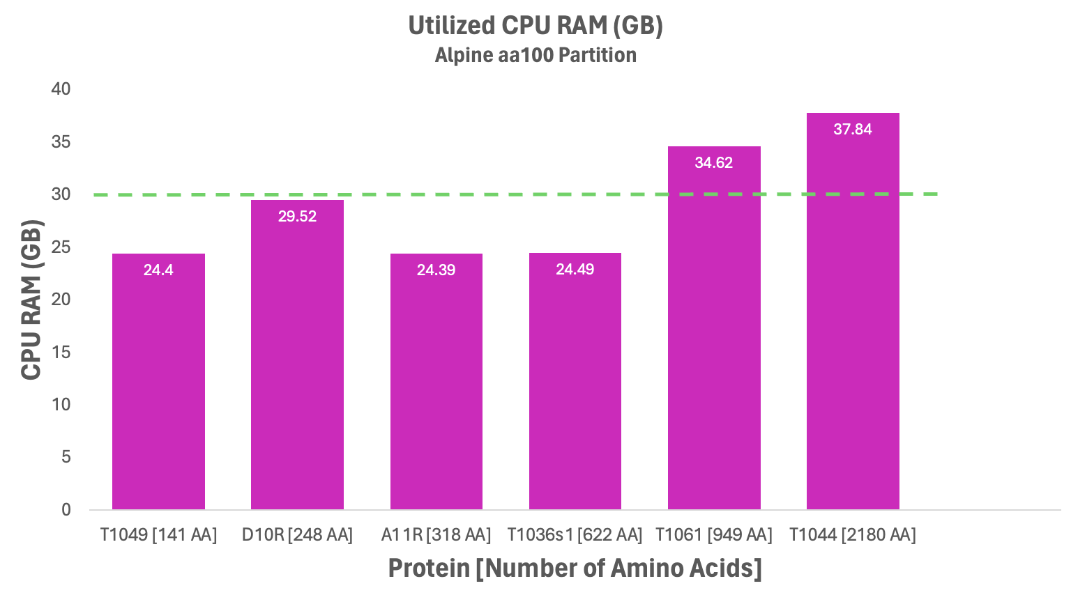
AlphaFold2 RAM Considerations
Requires
--mem directive
Notes:
Memory usage not necessarily linked to primary sequence length; MSA size is also a factor and so RAM can be a limiting factor if MSAs grow too large
On Alpine each CPU core provides ~3.8 GB RAM.
A sequence with 3000 residues or more will probably require 80GB GPUs, which we have a few of on Alpine. But for the majority of sequences, a 40GB VRAM A100 will be fine.

Slide 29
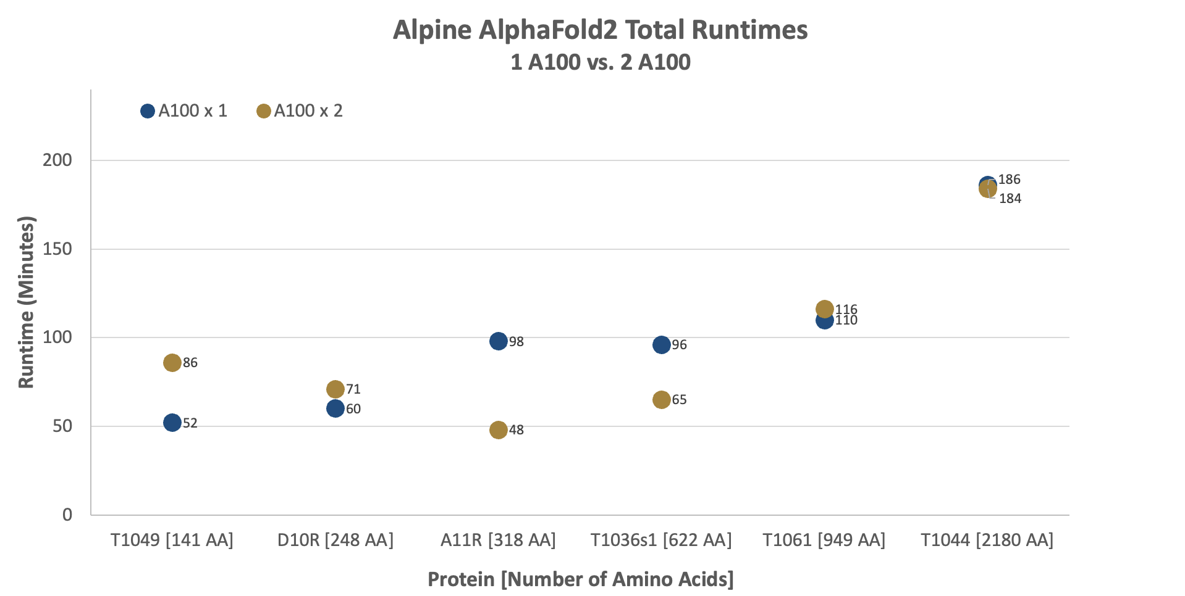
AlphaFold2 Alpine Benchmarks
Notes:
2 GPUs for single proteins don't reduce runtime!
AlphaFold does NOT support multiple GPUs. Please refrain from requesting more than one GPU per alphafold.py invocation, as this will not speed up your run time, and will inhibit your ability to have your job dispatched in a timely manner.

Slide 30
AlphaFold Spin-Offs: ParaFold (ParallelFold)
Divide CPU-intensive sections from the GPU-intensive sections
PF isn’t currently available as a module, but example scripts are available in /curc/sw/install/bio/parafold/2.0
parafold_cpu.sh
parafold_gpu.sh
Notes:
describe benefits (less wait times for you, more efficient system usage for us)
can copy scripts to your own space and edit as you need

Slide 31
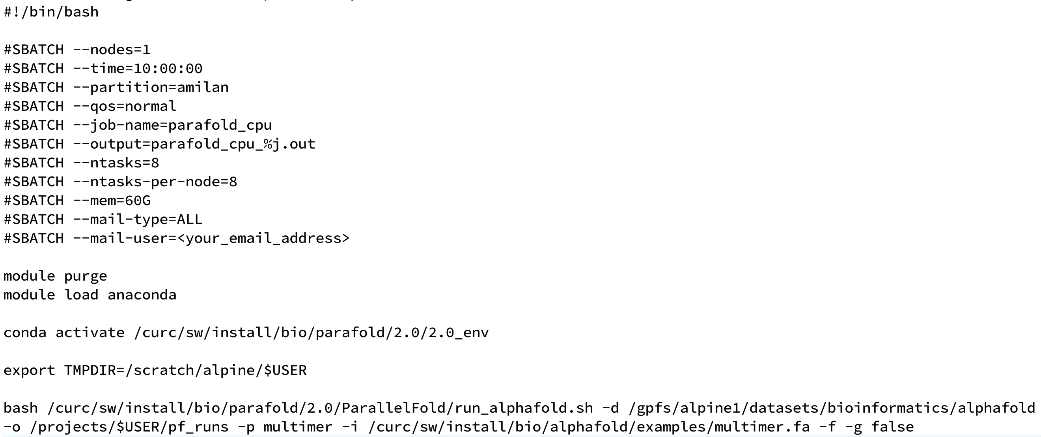
AlphaFold Spin-Offs: ParaFold Job Script
-f tells PF to stop after generating the feature.pkl file
Notes:
CPU script
multimers will use more mem and take longer, but still capped at 8 CPUs

Slide 32
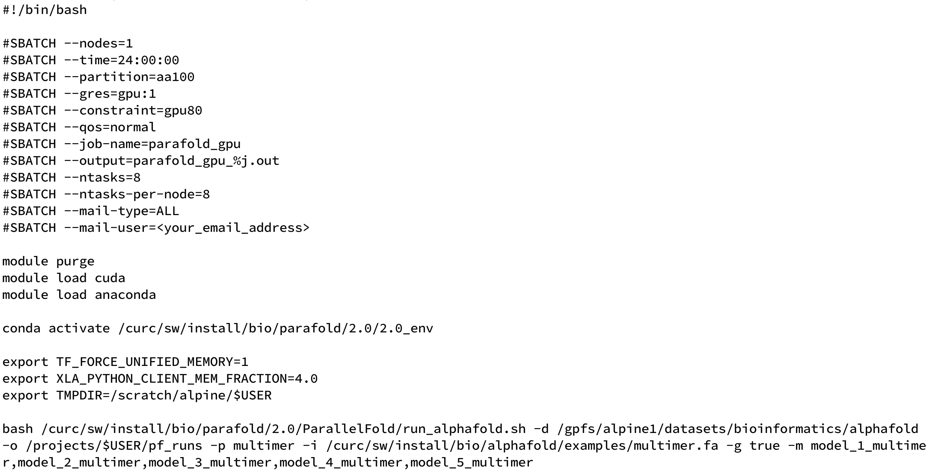
AlphaFold Spin-Offs: ParaFold Job Script Cont’d
Not needed for the multimer.fa example, but note that it is an option.
May need to add --mem directive for some predictions (relaxation step?)
Notes:
GPU script

Slide 33
Explore AlphaFold2 on Alpine
Slides/Self-guided material: https://bit.ly/af2alpine

Slide 34

Thank you Please give us your feedback! http://tinyurl.com/curc-survey18

